Slide 1
FROM SOUP TO NUTS or FACEBOOK TO PINTEREST TO YOUTUBE
Integrating Your Web 2.0 Presence
Phil Roeder, Director of Community Relations
CGCS Public Relations Executive Meeting

Slide 2
IN CASE YOU’RE TWEETING DURING THIS PRESENTATION
#WhyBotherWithSocialMedia
#TheDesMoinesApproach
#LessonsLearned

Slide 3
WHY BOTHER WITH SOCIAL MEDIA

Slide 4
THE SOCIAL MEDIA DEBATE IS OVER
If your district is debating the use of social media today, it was also probably debating:
Using a telephone in the 1920s?
Using a fax machine in the 1980s?
Using email and web sites in the 1990s?

Slide 5
WHY BE SOCIAL?
Mobility
Reaches everybody everywhere in real time
Everybody else is doing it!
67% of all adults on internet use social media (and 81% of adults use the internet)
Drive traffic to web site
Web site is now a platform, not a destination

Slide 6
EVERYONE & EVERYWHERE
Mobility
“Real time” reporting
The comfort of home (and anywhere else)

Slide 7
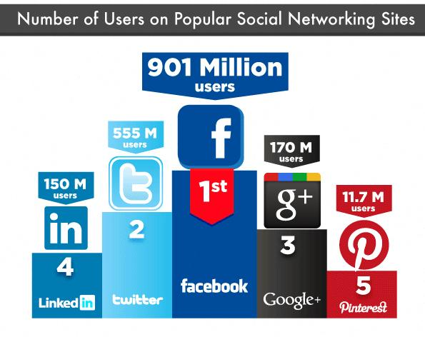
WHO’S EVERYBODY?

Slide 8
WHO’S EVERYBODY?

Slide 9
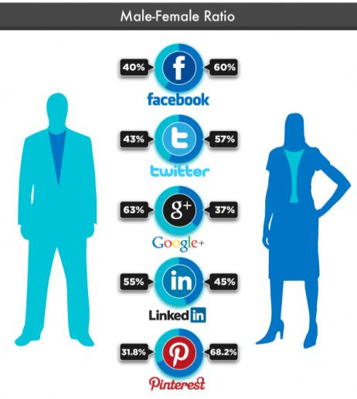
WHO’S EVERYBODY?

Slide 10
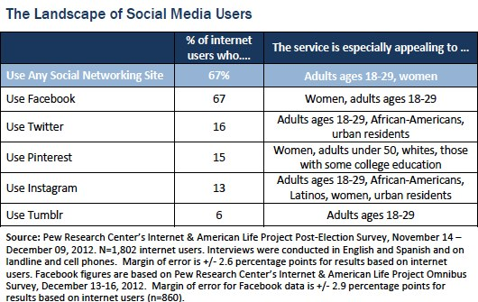
WHO’S EVERYBODY?

Slide 11
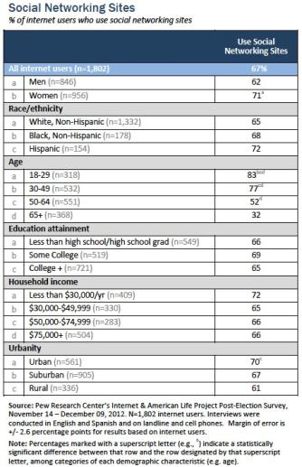
WHO’S EVERYBODY?

Slide 12
THAT WAS THEN
Just tell them to go to the damn website.

Slide 13
THIS IS NOW
We could always bring the website to them.

Slide 14
OR THAT WAS THEN

Slide 15
AND THIS IS NOW

Slide 16
THE DES MOINES APPROACH

Slide 17
DMPS JOINS THE 21st CENTURY
2011: DMPS had no social media presence.
Used YouTube, Flickr as online filing cabinets
Today: Integrating 6 social media tools with the district’s new website.
Driven by new web site and the need to “get with it”

Slide 18
DMPS JOINS THE 21st CENTURY
Develop our own “news network”
Use various media (words, photos, video)
Enhance outreach with those most interested
Bring the new web site to the community
Bring the community to the new web site

Slide 19
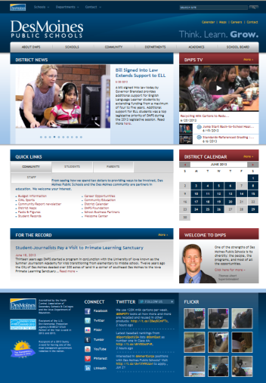
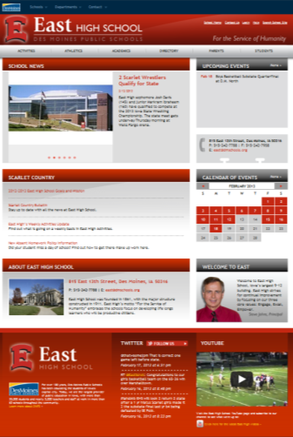
INTEGRATE WITH WEB SITES

Slide 20
FACEBOOK
/DMschools
More story focused.
Post summaries/share links of blog, news releases, announcements.

Slide 21
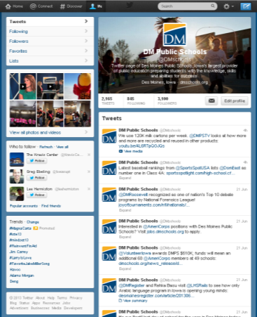
TWITTER
/DMschools
Link to (most) new web content
Reminders/announcements
Share/retweet
Fun facts and miscellany
Embedded on home page

Slide 22
PINTEREST
/DMschools
Pinterest founder is a DMPS alum
Similar postings to Facebook
More graphical

Slide 23
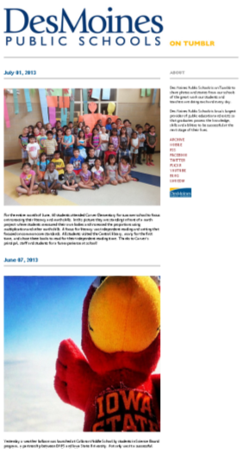
TUMBLR
DMschools. .com
Hundreds of snapshots received each year from our schools.
Opportunity to highlight images and stories shared by our schools.

Slide 24
FLICKR
/dmps
Library for 7,000+ photojournalist-quality photos.
Images shared on web site and social media.

Slide 25
YOUTUBE
/dmpstv
All programming available via YouTube
Latest programming embedded on home page
New programs shared via other social media

Slide 26
OUR NEXT FRONTIERS?
FOURSQUARE: Acquired our locations; determining if there is any value to putting it to use.
INSTRAGRAM: Begun slowly using for district; may encourage schools to use this for their photos.

Slide 27
LESSONS LEARNED

Slide 28
FRIENDS, LIKES AND FOLLOWERS
Use It, or Lose It
Regularly update your sites (or get rid of them)
Promote, Promote, Promote
Regularly notify parents, staff of sites; include in materials; advertise
Do Unto Others
Follow and connect with community, similar interests, media, etc.
Integrate, Integrate, Integrate
Connect web site and social media sites

Slide 29
DON’T KEEP IT A SECRET
Back to School billboard concept

Slide 30
EVEN A VIRTUAL SOCIETY HAS RULES
Find the right opened/closed balance
Encourage use but recognize consequences
Set clear guidelines for staff
i.e. don’t “like” your students, separate personal and classroom pages, etc.
Set clear expectations for the public
No one likes a #@%&!

Slide 31
EVEN A VIRTUAL SOCIETY HAS RULES
Please note that Des Moines Public Schools reserves the right to remove comments and/or block users on any of its social media sites who post comments which, in the school district’s sole discretion, bully, intimidate, or harass any individual; contain obscenity, nudity or gratuitous violence; are commercial or political solicitations; are factually erroneous, libelous, or wildly off-topic; are from anonymous blog trolls; or that otherwise violate State law, school district policy, or the guidelines of the social media sites.

Slide 32
THANK YOU

